Slide 1
Project Name: Online Unused Medicine Donation & Distribution Portal.
Project Members:
Abhijit Khairnar(210943120002).
Aditya Patil(210943120007).
Swaraj Devlalkar(210943120026).
Kuldeep Jhade(210943120044).

Slide 2
Introduction:
In this project we have prepared a portal for the collection of unused medicine for further utilization by a needy person.
The website is like user can donate the unused medicine to NGO. That NGO can help needy people.
Many poor people who do not afford to buy their own medicines, this website will help these people to get the medicine which they required to cure their respective diseases and the unused medicine will be utilized in good way.

Slide 3
Objective:
The aim of this project is to prepare a portal for the collection of unused medicines for a needy person.
In this project user can collect as well as donate the unused medicines to NGO and that NGO can further help needy person.
User will donate the medicines to NGO and NGO will verify all the medicines and they will help needy people by distributing them with the medicines they require.
Here we will provide Admin login, NGO login and User login. Admin will be able to see all details of user as well as NGO.
New user needs to register themself on a Registration form before login.

Slide 4
Modules:
Registration:- To register and get login credentials.
NGO Details:- Different NGO’s can connect with portal.
Admin Module: Used for managing Users,Ngo.
User details:- To Keep Users details.

Slide 5
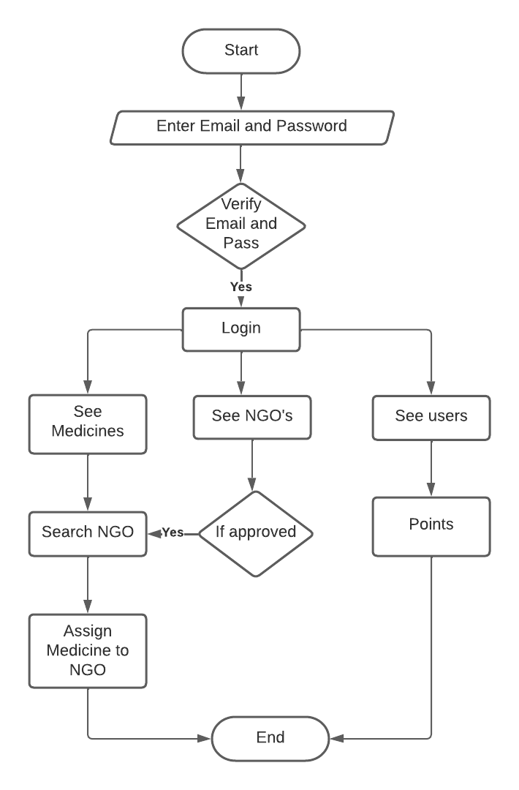
Activity Diagram Of Admin:

Slide 6
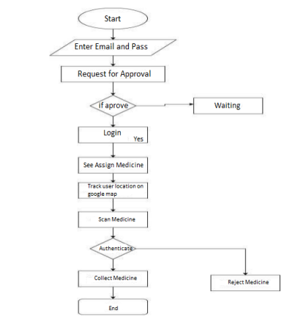
Activity Diagram Of NGO:

Slide 7
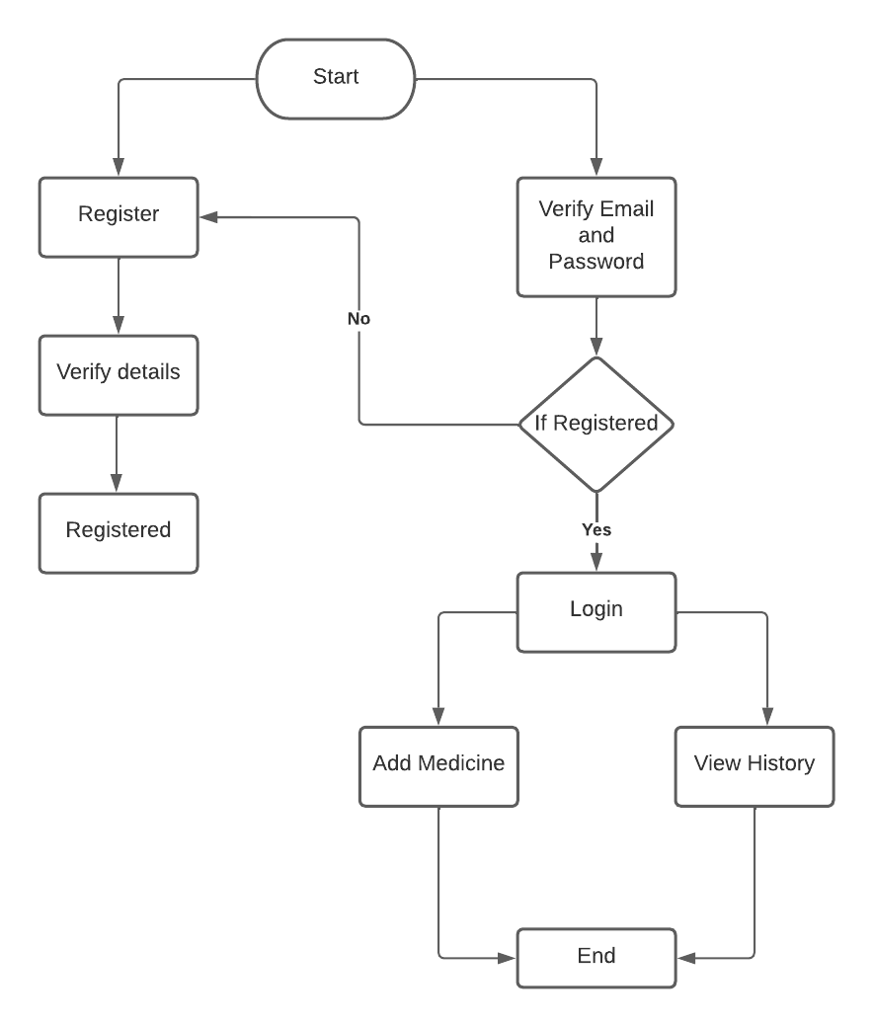
Activity Diagram Of User:

Slide 8
Future Scope:
This project in the future has the ability to become a full fledge application wherein all the facilities will be provided on this portal.
In future, it can be expanded to provide treatment to user via video consultancy with doctors providing prescription upload feature.
It can be very beneficial to user because as the current Pandemic situation it is very important to follow Governments rule and regulations.
For better suggestions, we are merging all the medication facility like consultation, medicine donation, blood donation, etc. like facilities are part of the portal in future.

